Slide 1
Digitizing Eugene Shoemaker’s Legacy
Virginia Crook – NASA Space Grant Intern
Marc Hunter – Mentor at USGS Astrogeology Science Center

Slide 2
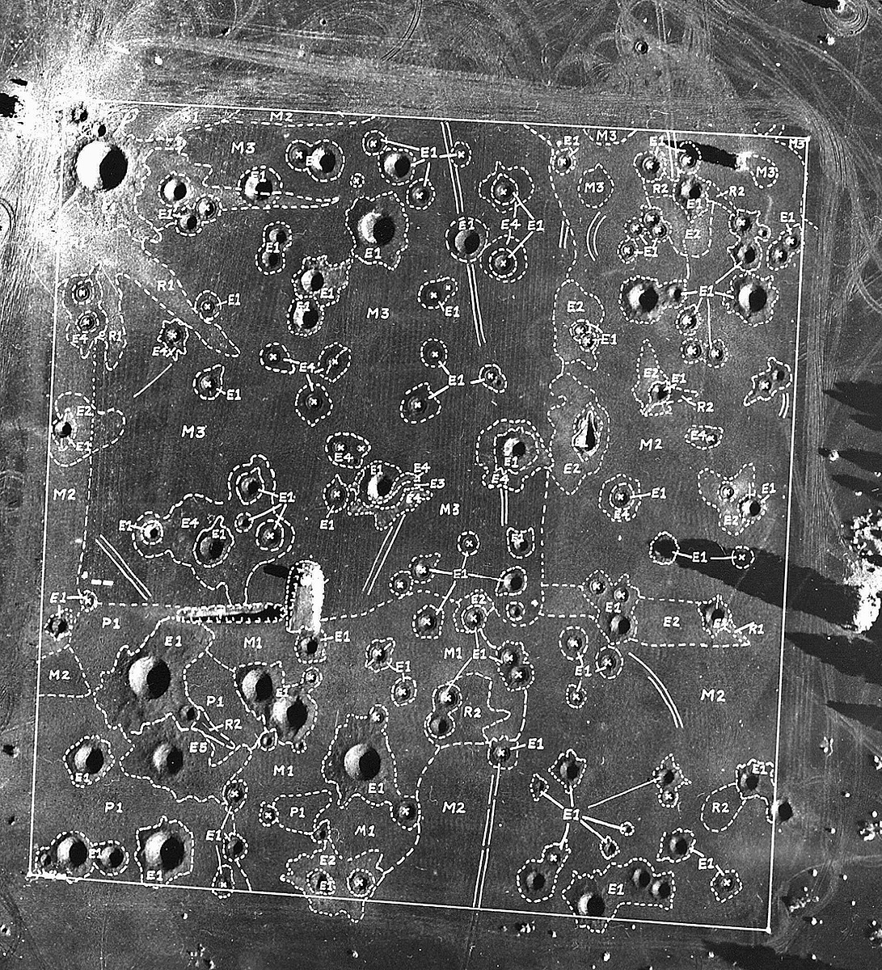
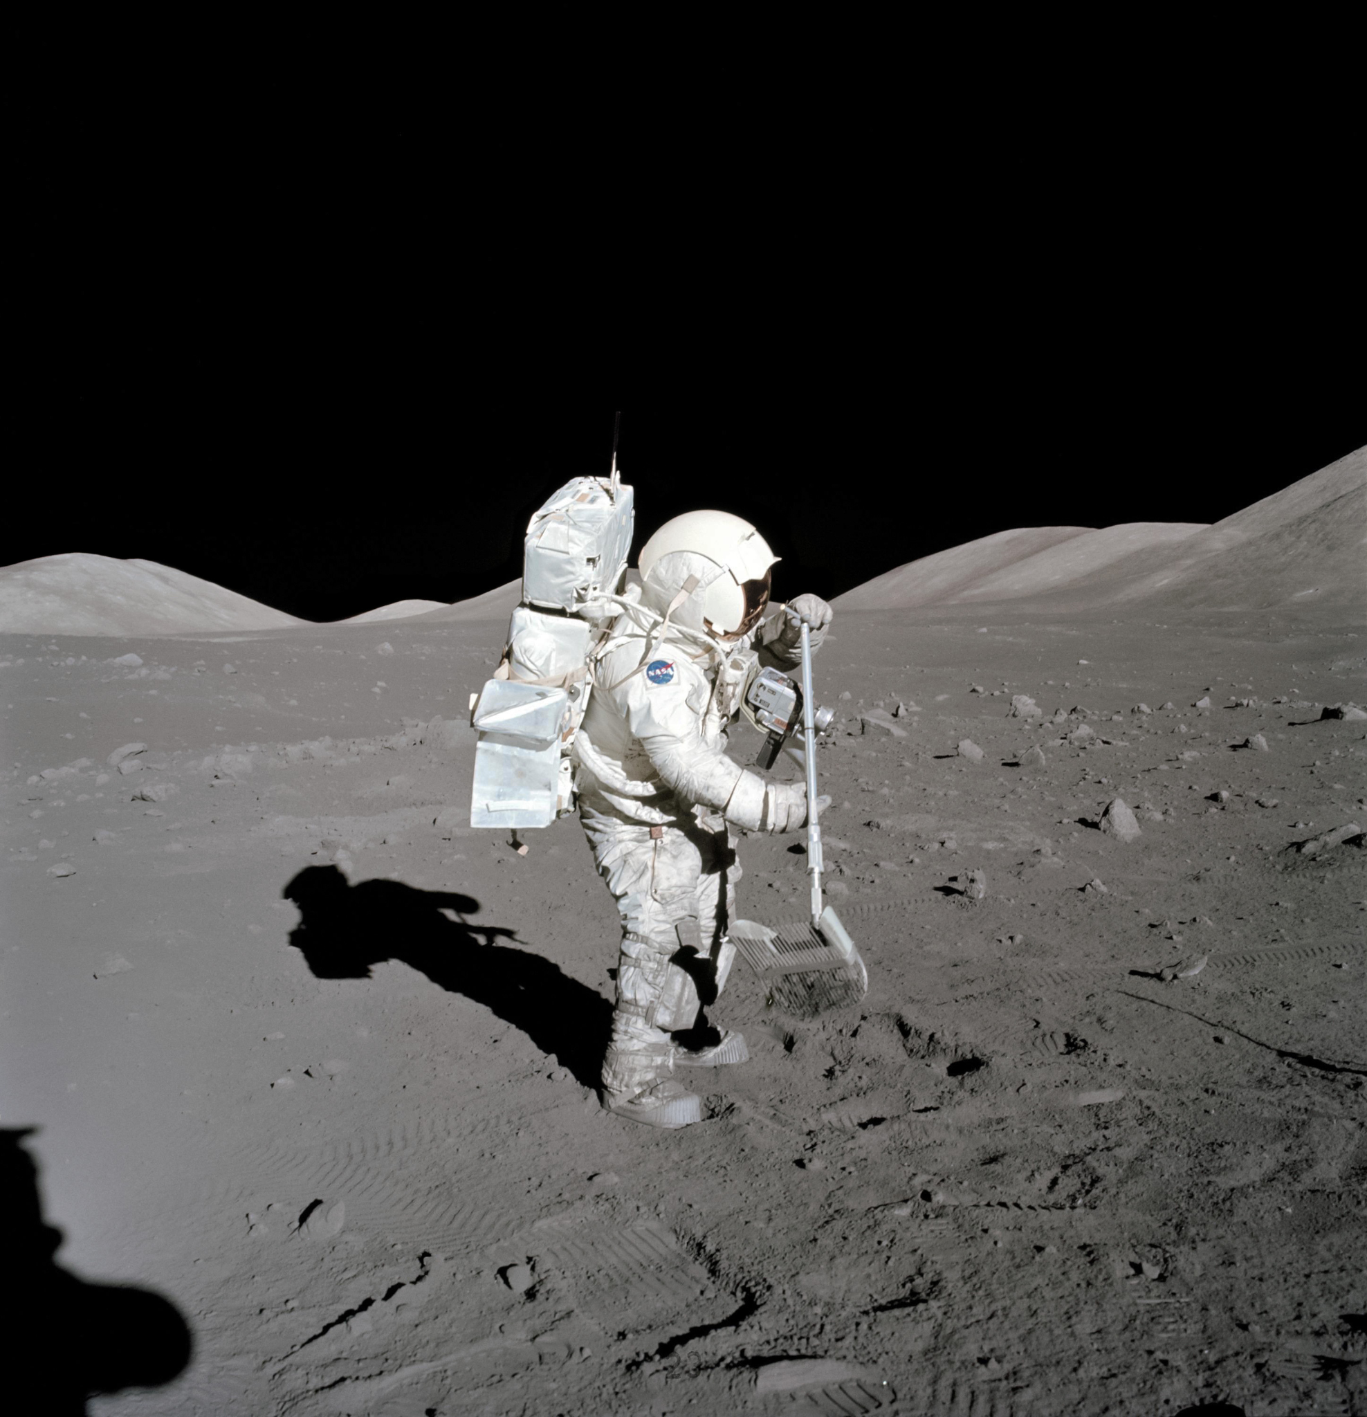
Cinder Lake Crater Field
Astronaut collecting a lunar rock sample

Slide 3
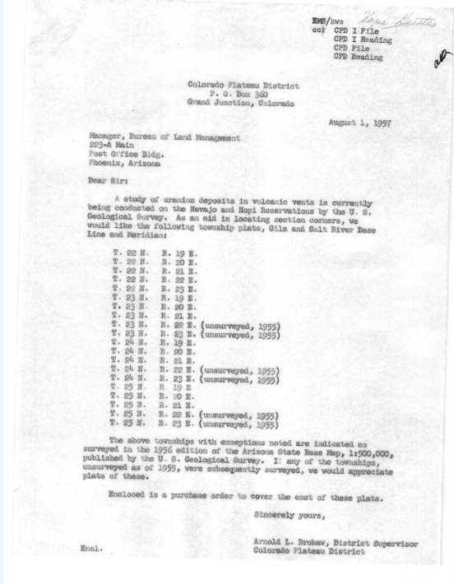
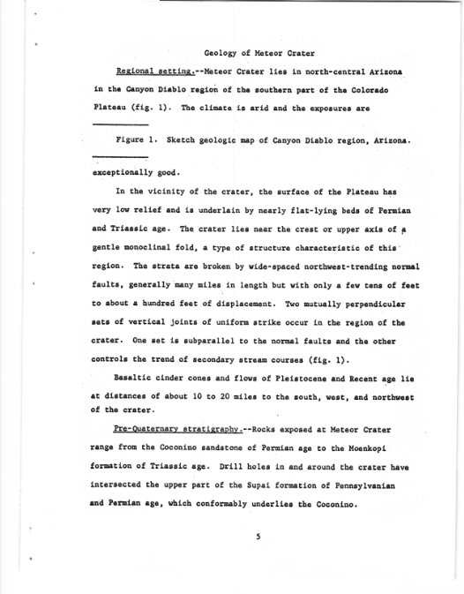
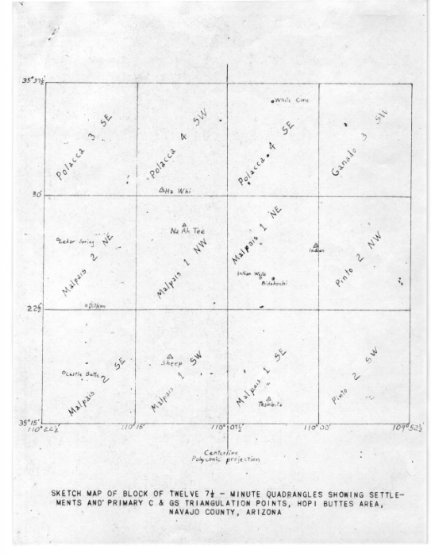
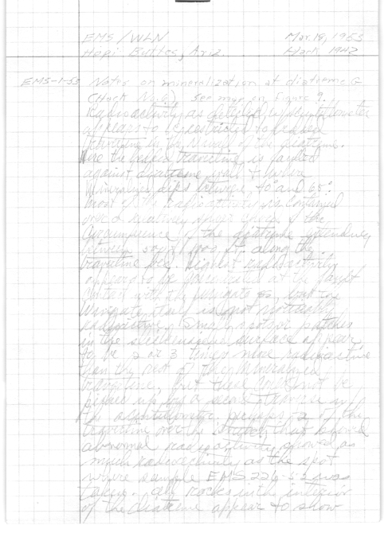
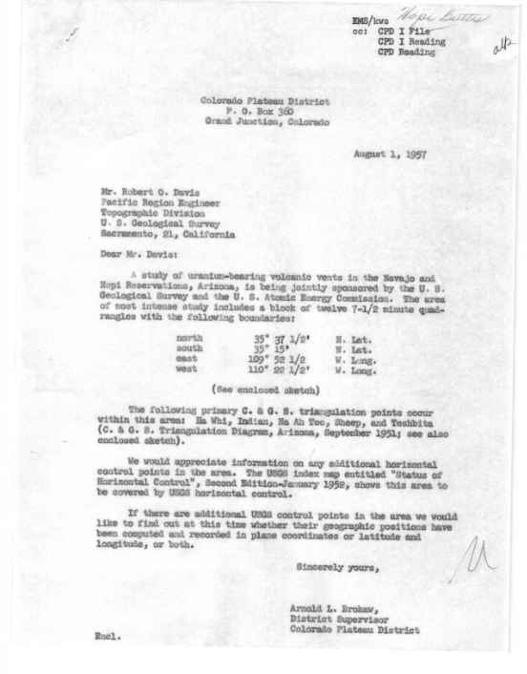
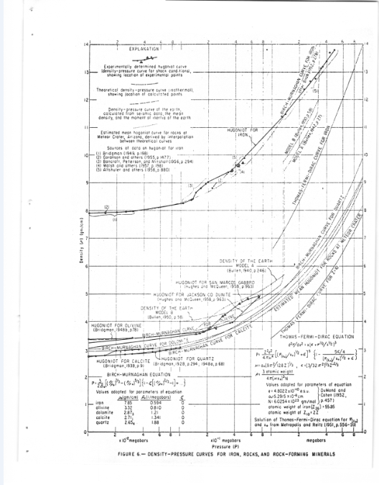
A Letter from Shoemaker’s colleague to Mr. Robert O Davis, Pacific Region Engineer
Final draft of Impact Mechanics at Meteor Crater
Eugene Shoemaker’s Field Notes
Sketch Map of Minute Quadrangles in Navajo County, AZ
Final graph in Impact Mechanics at Meteor Crater
A Letter from Shoemaker’s colleague to the Bureau of Land Management

Slide 4
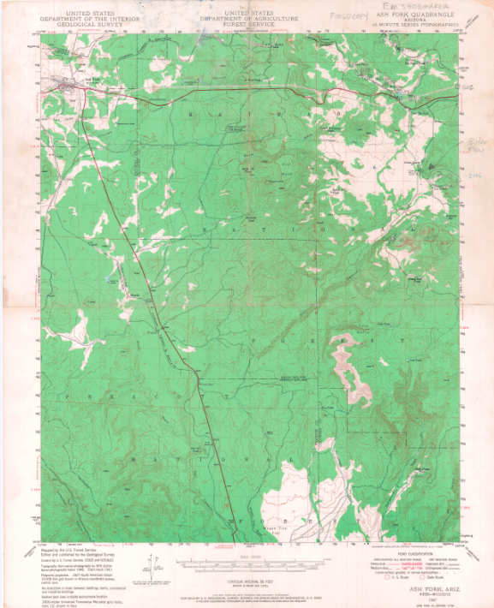
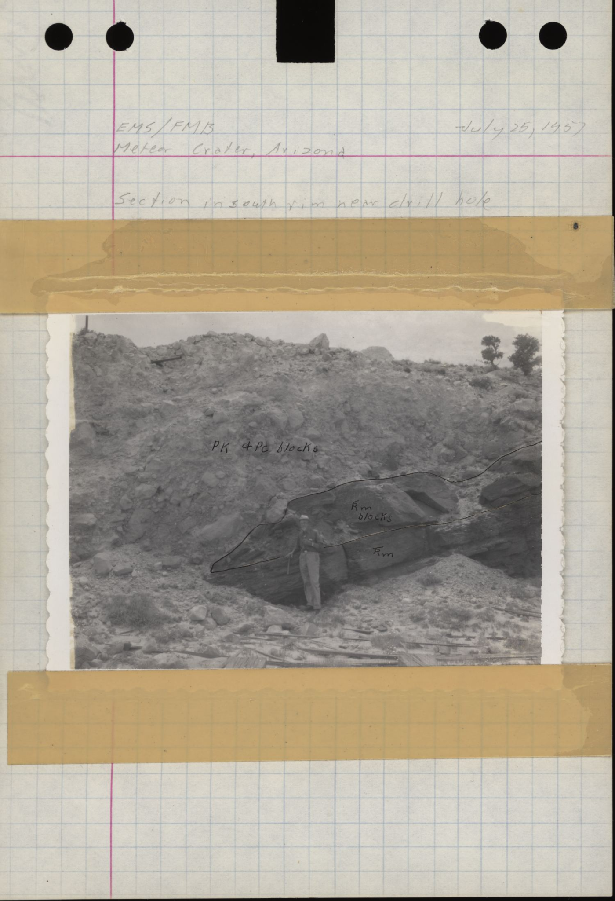
Ash Fork Map, Shoemaker Collection
Photo taken in-situ, Meteor Crater, AZ

Slide 5
Standard Operating Procedure
Digitization
OCR & Accessibility
Metadata
Upload for public access

Slide 6
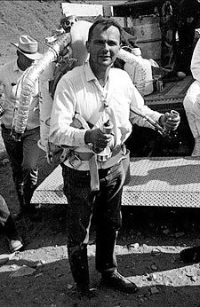
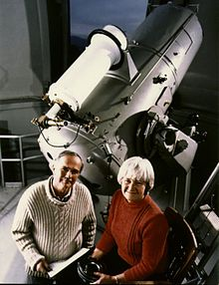
Eugene Shoemaker training astronauts while wearing a Bell Rocket Belt
Eugene and Carolyn Shoemaker, Palomar Observatory, 1994

Slide 7
Thank You
Any Questions?
vc573@nau.edu

